Slide 1

Presented BY: Hritik

Slide 2
INTODUCTION:
BigBasket is one of India's leading online grocery delivery services, offering a wide range of products, including fresh fruits, vegetables, dairy, packaged foods, personal care items, and household essentials. Founded in 2011, the company has grown rapidly, providing customers with a convenient and efficient way to shop for groceries from the comfort of their homes.
BigBasket operates in multiple cities across India and has expanded its services through quick delivery options, scheduled deliveries, and express grocery delivery under its "BB Now" service. The platform also offers its own private-label products and works with local farmers and suppliers to ensure quality and affordability.
In 2021, Tata Group acquired a majority stake in BigBasket, further strengthening its position in India's e-commerce and retail sector. The company continues to innovate with AI-driven inventory management, seamless app-based shopping, and partnerships with various brands to enhance the customer experience.

Slide 3
Objective:
1. Understanding Sales Trends:
Identifying the best and least-selling products.
2. Pricing & Discounts Analysis:
Measuring discount percentages on different products.
3. Brand Performance Analysis:
Evaluating the popularity and ratings of different brands.
4. Category-Wise Product Distribution:
Finding the number of products in each category.
5. Data Cleaning & Preparation:
Handling missing values, outliers, and ensuring data consistency.

Slide 4
IMPORTING PYTHON LIBRARY:
Pandas –> A powerful data manipulation and analysis library in Python. It provides data structures like DataFrames and Series to handle structured data efficiently. It is widely used for data cleaning, transformation, and analysis.
Numpy –> A fundamental package for numerical computing in Python. It supports multi-dimensional arrays and mathematical functions for fast numerical computations. Essential for scientific computing and data analysis.
Seaborn –> A visualization library built on matplotlib, designed for statistical data visualization. It provides beautiful and informative graphs, such as histograms, box plots, and correlation heatmaps, making it easier to explore data patterns.
Matplotlib.pyplot –> A core plotting library in Python, allowing users to create a variety of static, animated, and interactive visualizations, such as line charts, bar charts, and scatter plots.

Slide 5





plotly.express –>A high-level interface for interactive and dynamic visualizations. It is particularly useful for creating visually appealing charts with zooming, hovering, and filtering capabilities.
warnings (warnings.filterwarnings("ignore")) –> The warnings module helps manage warning messages in Python. The filterwarnings("ignore") function suppresses unnecessary warnings, improving readability when running scripts.

Slide 6
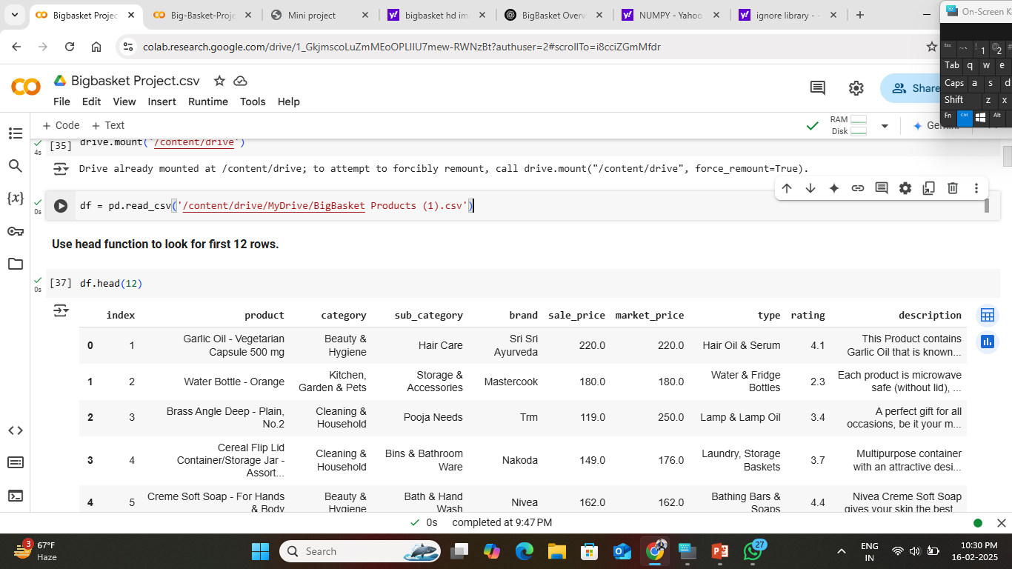
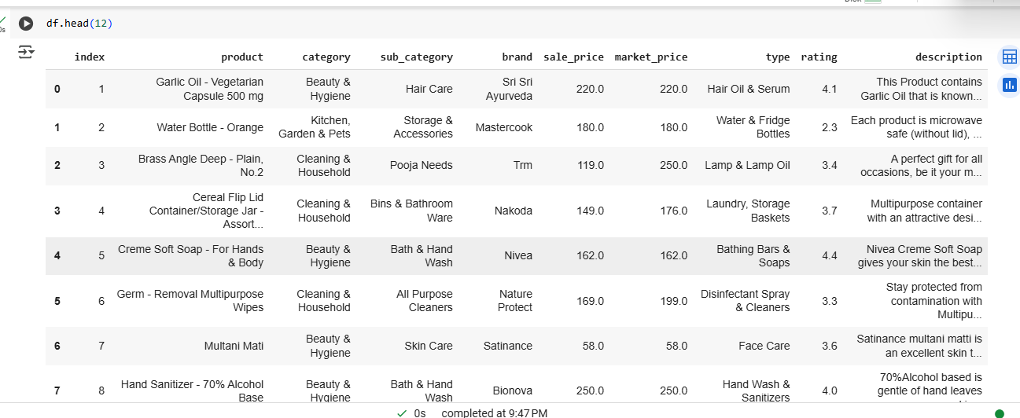
Define/Read the Dataset
Read the dataset and use .head to see the first 13 row of the dataset.

Slide 7
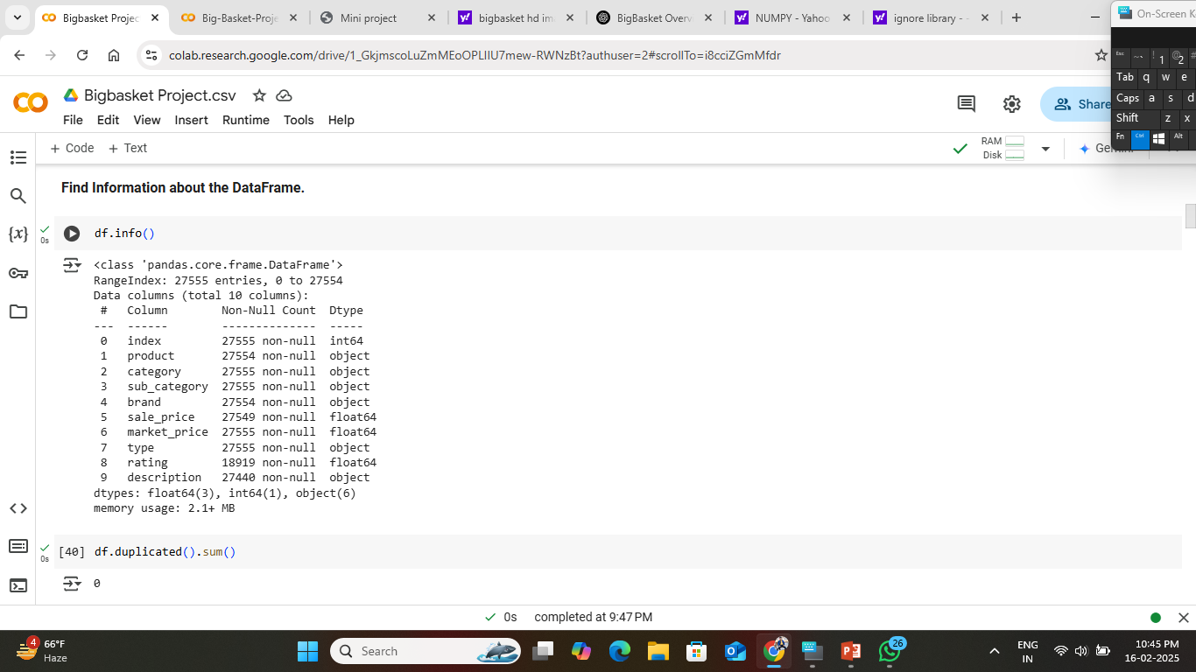
INFORMATION ABOUT TH DATASET:
As you can see that the dataset contain the 27,555 rows and 10 columns.
The dataset consumes 2.1 MB of memory.
Index (int64): A unique identifier for each row.
product (object): Name of the product (1 missing value).
category (object): The main category of the product.
Sub_category (object): A more detailed classification within the category.
brand (object): The brand of the product (1 missing value).
sale_price (float64): The discounted price (6 missing values).
market_price (float64): The original price before discount.
type (object): Likely indicates the type of product.
rating (float64): Customer rating (significant missing values).
description (object): Product description (115 missing values).

Slide 8
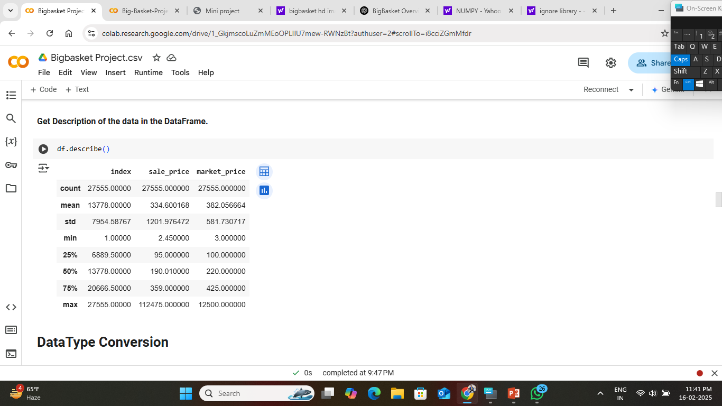
DESCRIPTION ABOUT THE DATASET

Slide 9
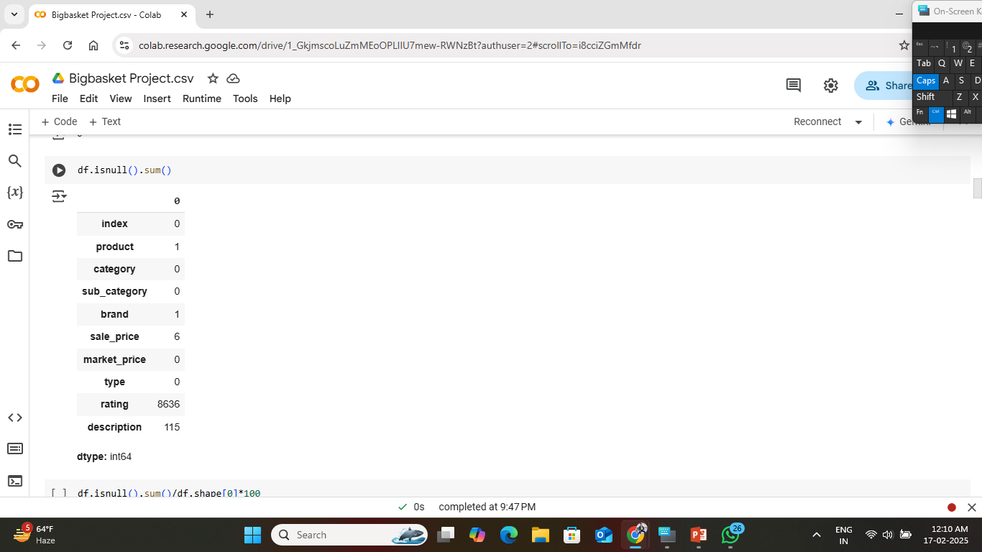

MISSING VALUES FIND OUT:
In Both the picture you can see the sum of all the null value present in the columns and also shows how much percentage of null values in the columns

Slide 10
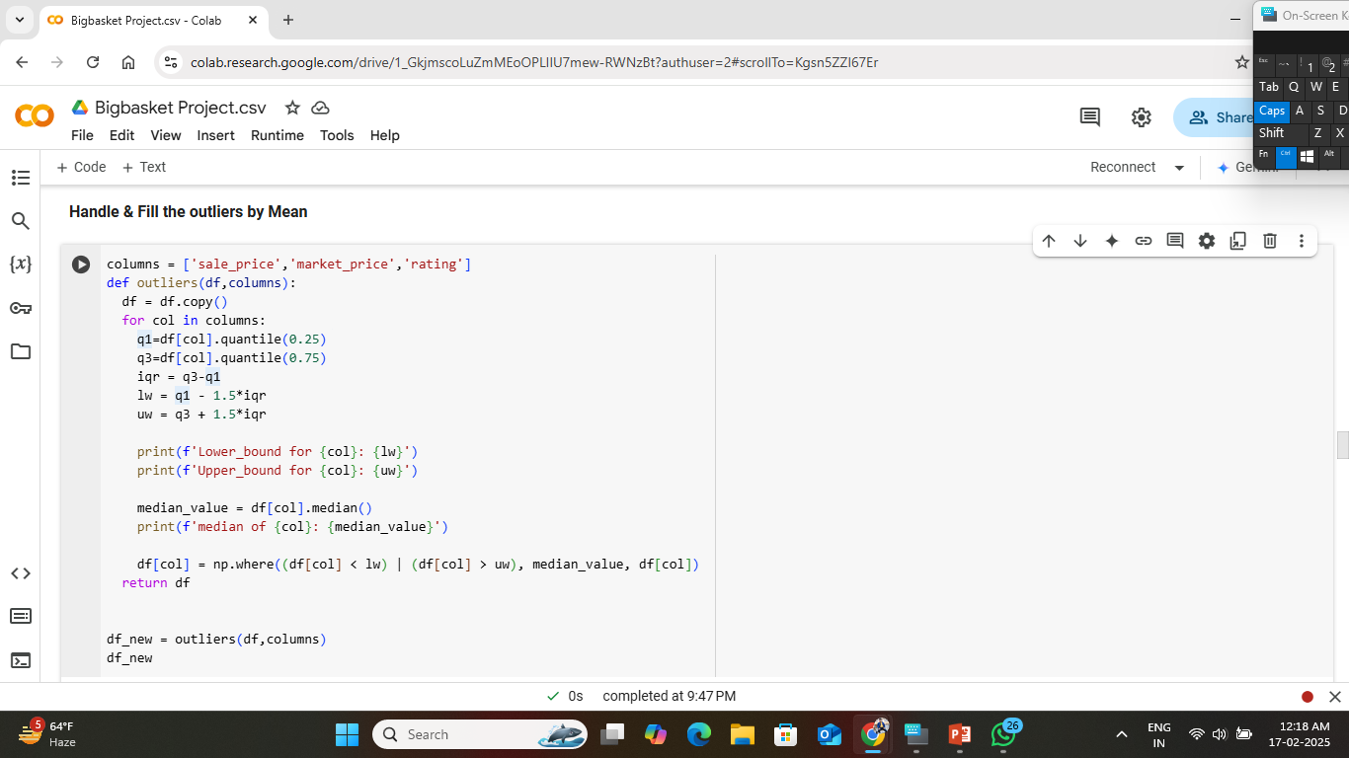
HANDLING THE OUTLIERS:
Using IQR (Inter quantile range) method to detect the outliers.
q1=df[col].quantile(0.25)
q3=df[col].quantile(0.75)
iqr = q3-q1
lw = q1 - 1.5*iqr
uw = q3 + 1.5*iqr
q1,q2(quantile1,quantile2),
lw,uw (lower whisker, upper whisker)

Slide 11
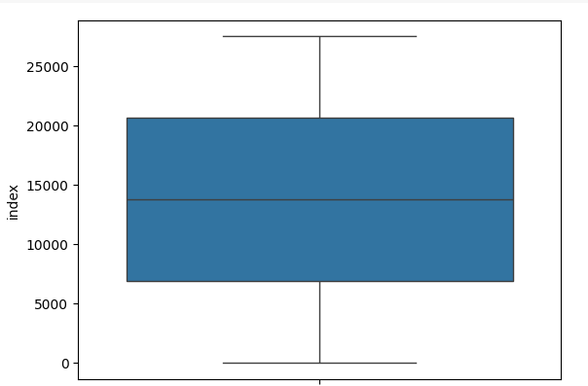
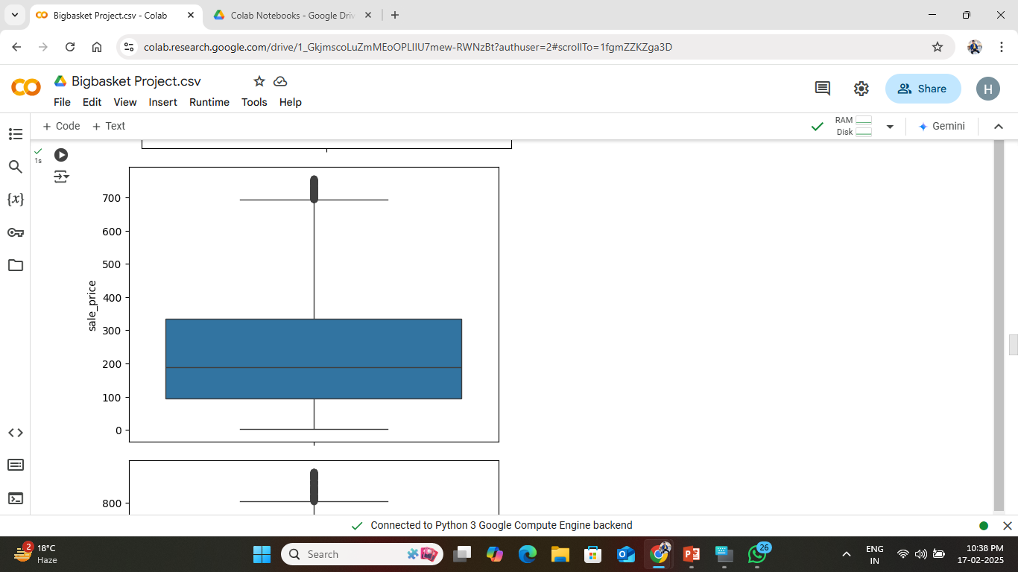

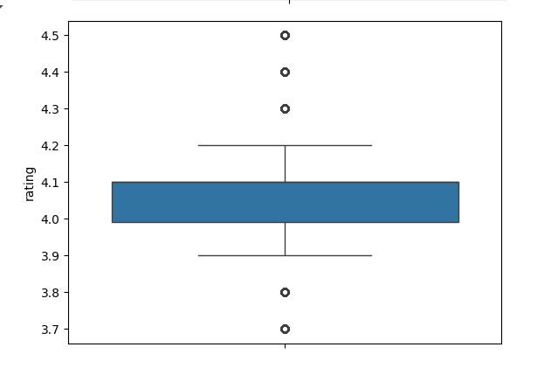
HANDLING THE OUTLIERS:
for i in df_new.select_dtypes(include='number'):
sns.boxplot(y=df_new[i])
plt.show()

Slide 12
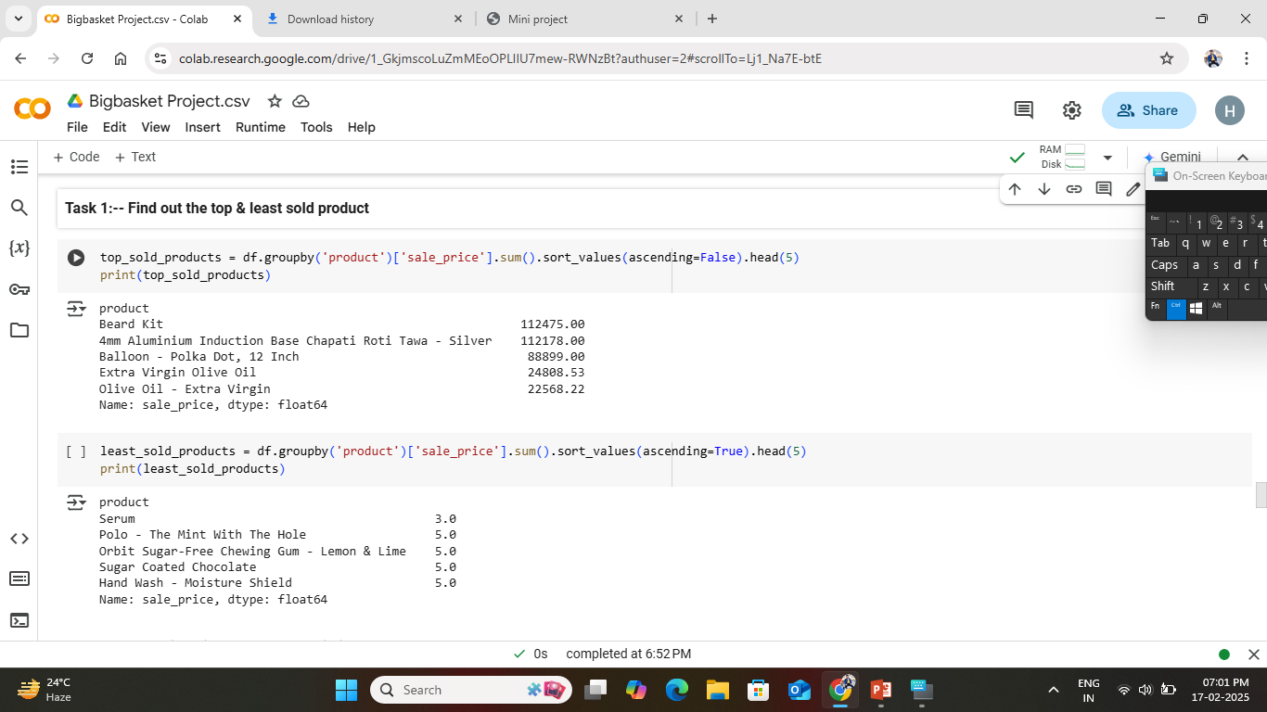
ANALYSIS:
Task: : Find out Top & least sold products.
High-value products like Beard Kit and Olive Oil - Extra Virgin contribute significantly to total revenue.
Some low-cost or niche products, such as Serum and Hand Wash - Moisture Shield, have minimal sales.
This analysis helps in identifying the best and worst-performing products based on total sales revenue, which can be useful for inventory management, marketing strategies, and sales optimization.

Slide 13
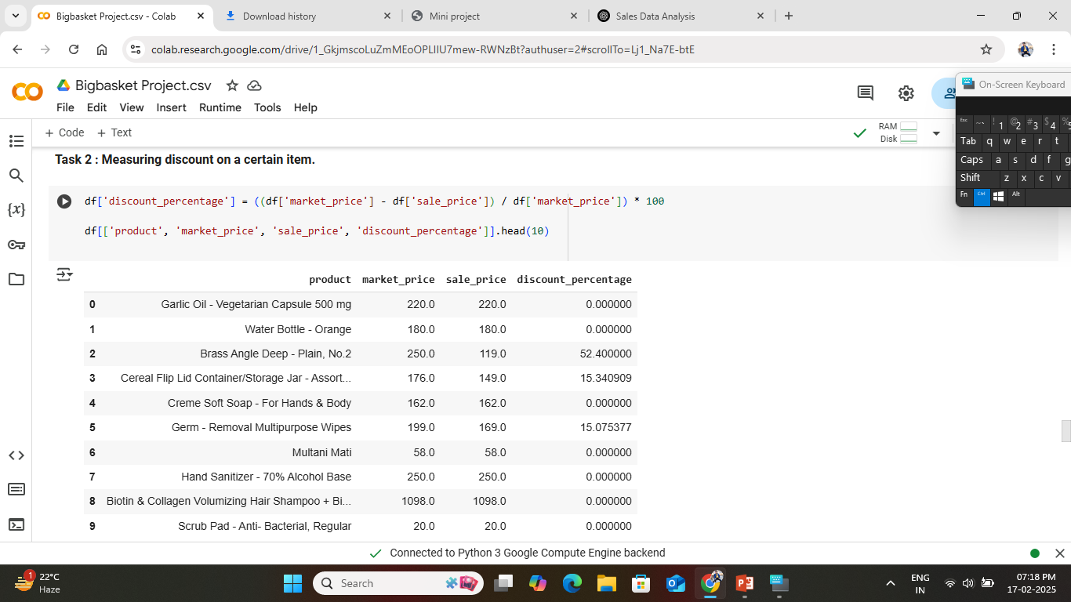
Task: Measuring discount on a certain item.
Calculating Discount Percentage: The formula used to compute the discount percentage is:
Discount_percentage = (Market price – Sale price) / Market price *100
This formula determines the percentage difference between the market price and the sale price for each product.

Slide 14
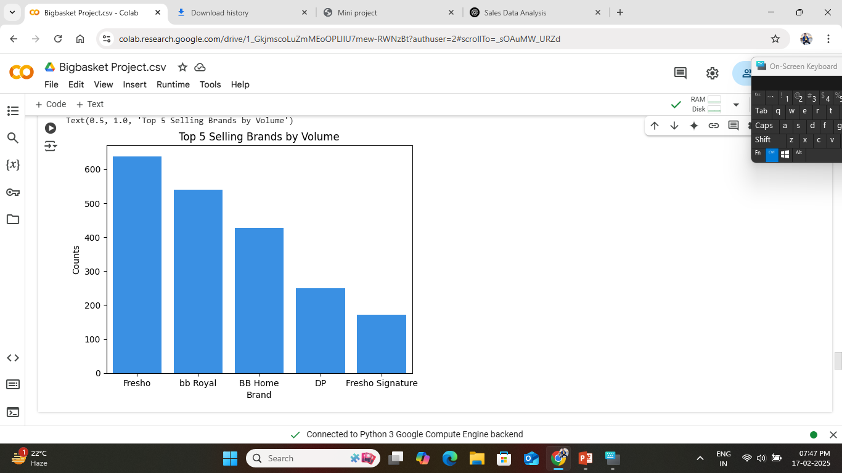
Visualizations the graph
Create Plots of first 5 brand with the Sale price
A bar chart displaying the top 5 selling brands based on the number of products sold.
The brand with the highest sales volume will have the tallest bar.
The visualization helps identify the most popular brands in the dataset.

Slide 15
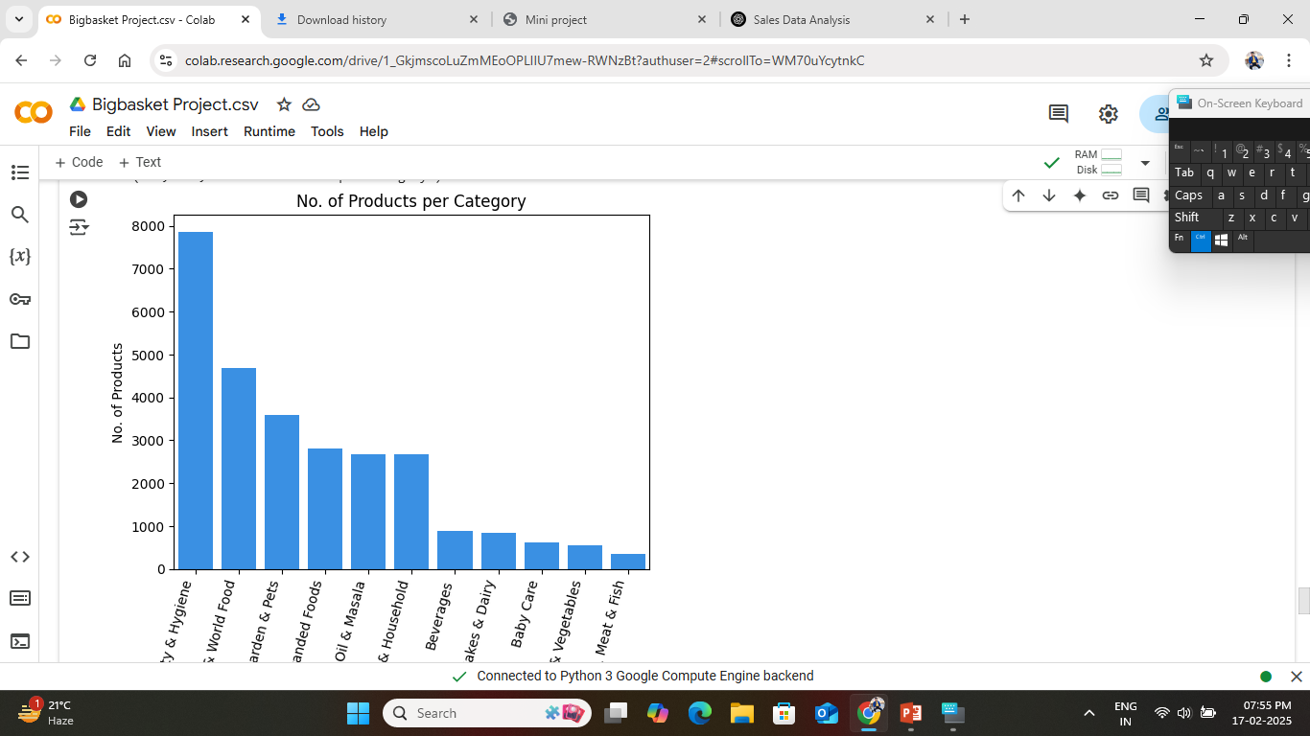
Number of Products Per Category.
A bar chart displaying the number of products in each category.
Categories with a higher number of products will have taller bars.
The x-axis labels are rotated to avoid overlap and improve readability

Slide 16
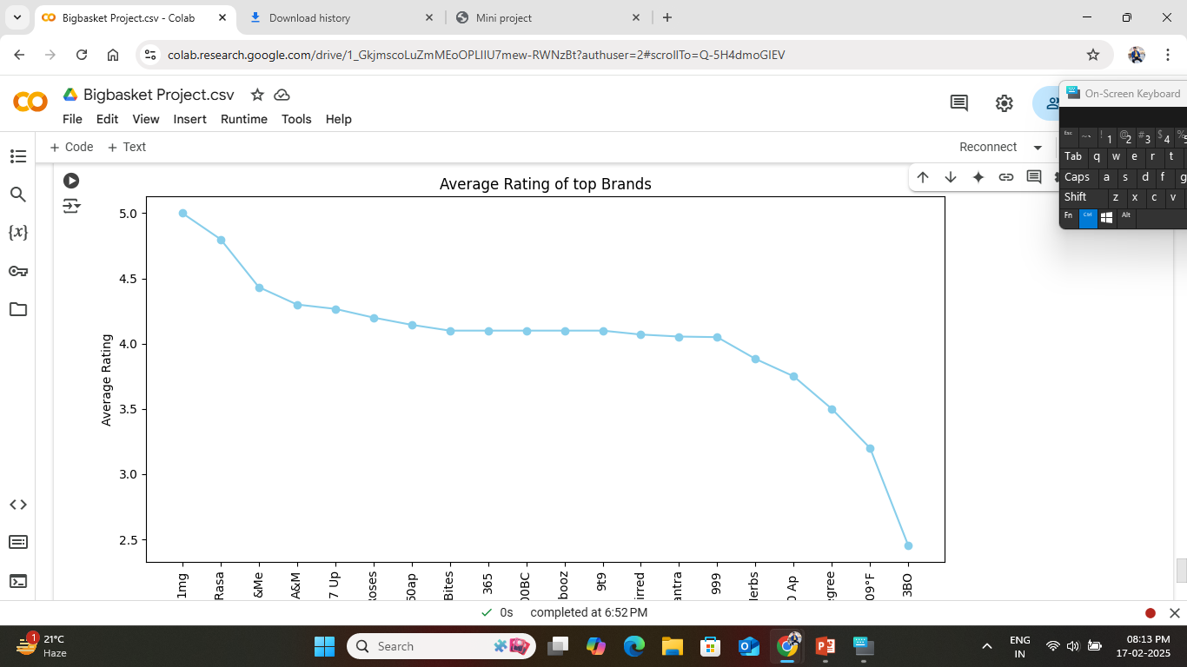
Average rating of Top Brands.
A line plot displaying the average rating of the top 20 brands.
Brands with higher average ratings will appear towards the top.
The x-axis will show brand names, and the y-axis will show their corresponding average ratings.
It helps identify which brands have the highest customer satisfaction based on ratings.
It Useful for brand performance evaluation and market positioning.

Slide 17
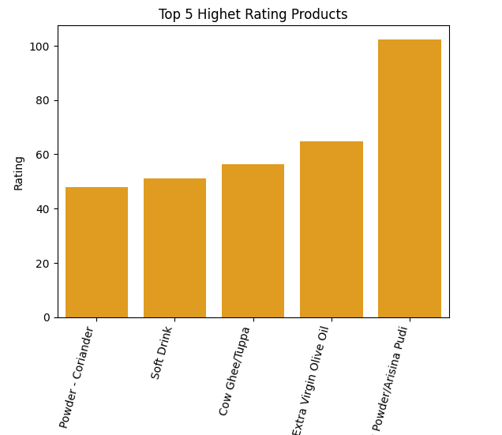
Top Five Highest Rating Products
In the graph we can see the Top 5 rting products:
Turmeric Powder/ Arisina Pudi is the most well-received product, possibly due to high customer satisfaction.
Other products like Extra Virgin Olive Oil and Cow Ghee/Tuppa also have strong ratings, indicating customer preference for health-related items.
Soft Drink making it into the top 5 suggests that it is a popular choice among consumers.

Slide 18
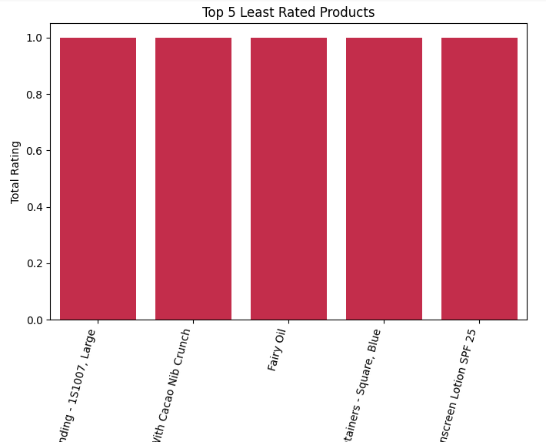
Top Five Least Rating Products
In this graph we can shown the top 5 least rating product.
Each of the five products has a total rating of just 1.0, suggesting minimal customer engagement.
This shows the lack of customers reviews rather than poor quality.

Slide 19
THANK YOU
Link : https://colab.research.google.com/drive/1_GkjmscoLuZmMEoOPLIIU7mew-RWNzBt?authuser=2

